Slide 1
Dynamic-Domain RRTs: Efficient Exploration by Controlling the Sampling Domain
Anna Yershova¹ Léonard Jaillet² Thierry Siméon² Steven M. LaValle¹
¹Department of Computer Science
University of Illinois
Urbana, IL 61801 USA
{yershova, lavalle}@uiuc.edu
²LAAS-CNRS
7, Avenue du Colonel Roche
31077 Toulouse Cedex 04,France
{ljaillet, nic}@laas.fr
Thanks to: US National Science Foundation, UIUC/CNRS funding, Kineo

Slide 2
Rapidly-exploring Random Trees (RRTs)
Introduced by LaValle and Kuffner, ICRA 1999.
Applied, adapted, and extended in many works: Frazzoli, Dahleh, Feron, 2000; Toussaint, Basar, Bullo, 2000; Vallejo, Jones, Amato, 2000; Strady, Laumond, 2000; Mayeux, Simeon, 2000; Karatas, Bullo, 2001; Li, Chang, 2001; Kuffner, Nishiwaki, Kagami, Inaba, Inoue, 2000, 2001; Williams, Kim, Hofbaur, How, Kennell, Loy, Ragno, Stedl, Walcott, 2001; Carpin, Pagello, 2002; Branicky, Curtiss, 2002; Cortes, Simeon, 2004; Urmson, Simmons, 2003; Yamane, Kuffner, Hodgins, 2004; Strandberg, 2004; ...
Also, applications to biology, computational geography, verification, virtual prototyping, architecture, solar sailing, computer graphics, ...

Slide 3
The RRT Construction Algorithm
GENERATE_RRT(x_{init}, K, Δt)
T.init(x_{init});
For k = 1 to K do
x_{rand} ← RANDOM_STATE();
x_{near} ← NEAREST_NEIGHBOR(x_{rand}, T);
if CONNECT(T, x_{rand}, x_{near}, x_{new});
T.add_vertex(x_{new});
T.add_edge(x_{near}, x_{new}, u);
Return T;
x_{near}
x_{new}
x_{init}
The result is a tree rooted at x_{init}

Slide 4

A Rapidly-exploring Random Tree (RRT)
Notes:
Here is an example of the RRT growing in the square environment with no obstacles.

Slide 5
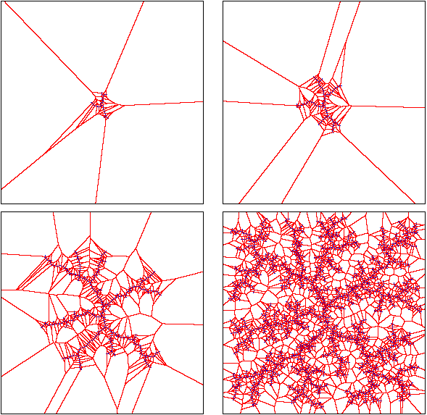
Voronoi Biased Exploration
Is this always a good idea?
Notes:
In this work we investigate the Voronoi bias which controls the growth of the tree
At different stages consider the Voronoi regions of the nodes in the tree. The tree grows in the directions of the largest Voronoi regions.

Slide 6

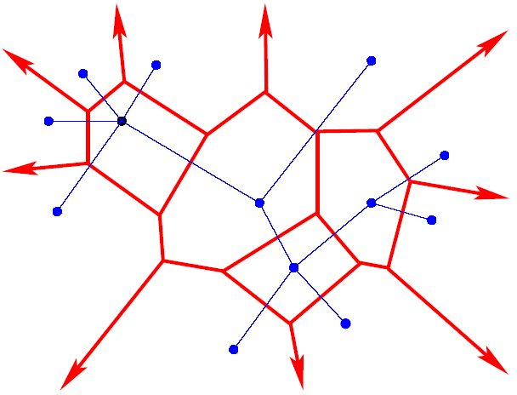
Voronoi Diagram in R ²
Notes:
More carefully, consider a simple Voronoi diagram of some tree. We differentiate between the two types of Voronoi regions.

Slide 7
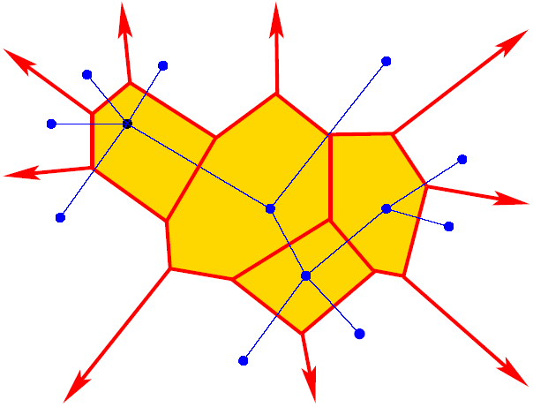
Voronoi Diagram in R ²

Slide 8
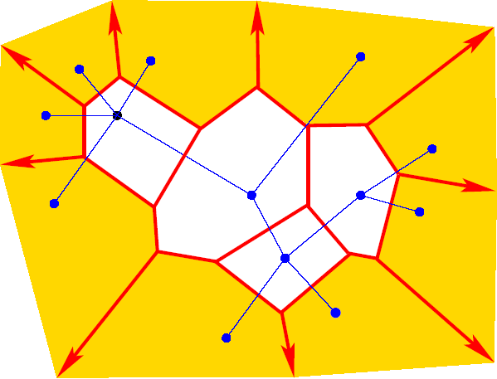
Voronoi Diagram in R ²

Slide 9
Refinement vs. Expansion
refinement
expansion
Where will the random sample fall? How to control the behavior of RRT?
Notes:
If the random sample falls in …… These two modes of behavior are controlled by Voronoi bias only. We want to learn to control it.

Slide 10
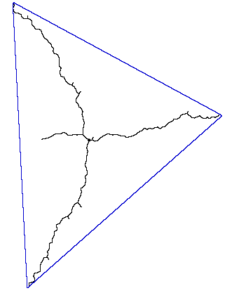

Limit Case: Pure Expansion
Let X be an n-dimensonal ball,
in which r is very large.
The RRT will explore n + 1 opposite directions.
The principle directions are vertices of a regular (n + 1)-simplex

Slide 11
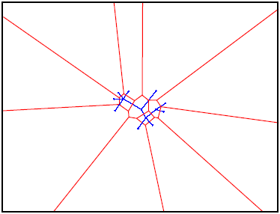
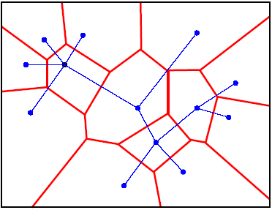
Determining the Boundary
Expansion dominates
Balanced refinement and expansion
The tradeoff depends on the size of the bounding box
Notes:
in general, changing the boundary of the domain controls the two modes in some way

Slide 12
Controlling the Voronoi Bias
Refinement is good when multiresolution search is needed
Expansion is good when the tree can grow and not blocked by obstacles
Main motivation:
Voronoi bias does not take into account obstacles
How to incorporate the obstacles into Voronoi bias?

Slide 13
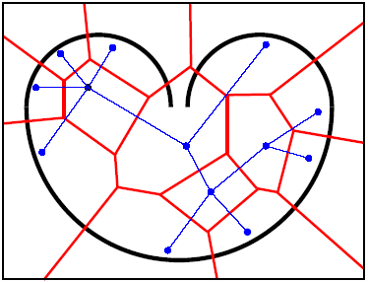
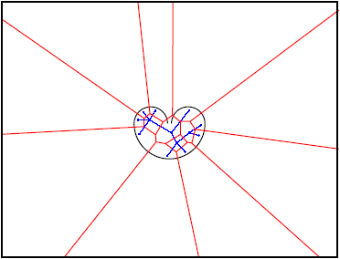
Bug Trap
Small Bounding Box Large Bounding Box
Which one will perform better?
Notes:
In order to investigate this we consider a toy example. A 3-d bug trap is a device for catching bugs. If the food (something sweet) is put inside the trap, the bug can get easily inside, but can never leave the trap. Already by constraining the boundary would improve the performance, since…. However, let’s consider Voronoi regions more carefully.

Slide 14
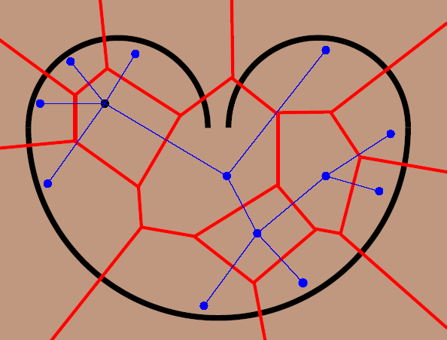
Voronoi Bias for the Original RRT

Slide 15
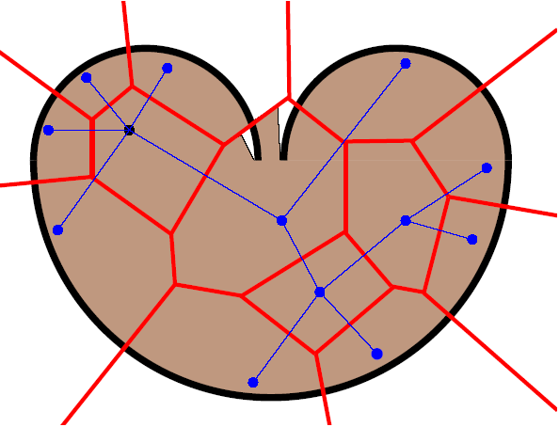
Visibility-Based Clipping of the Voronoi Regions
Nice idea, but how can this be done in practice?
Even better: Voronoi diagram for obstacle-based metric
Notes:
If this would be for free – the tree would grow in the same manner as the rrt but the expensive collision checks would be saved. The idea is to use the restricted Voronoi regions but which is cheaper to compute.

Slide 16
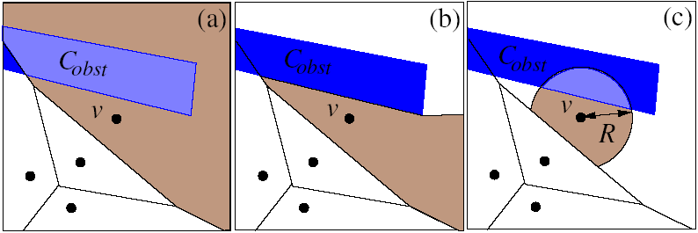
A Boundary Node
(a) Regular RRT, unbounded Voronoi region
(b) Visibility region
(c) Dynamic domain

Slide 17
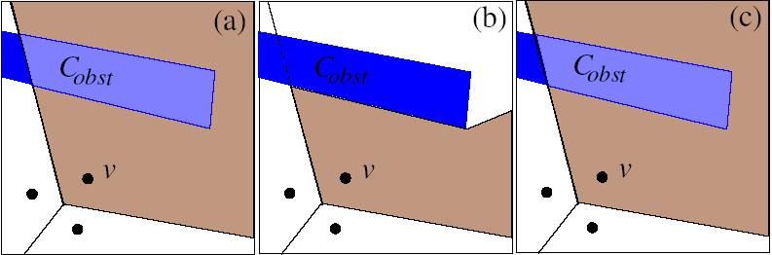
A Non-Boundary Node
(a) Regular RRT, unbounded Voronoi region
(b) Visibility region
(c) Dynamic domain

Slide 18
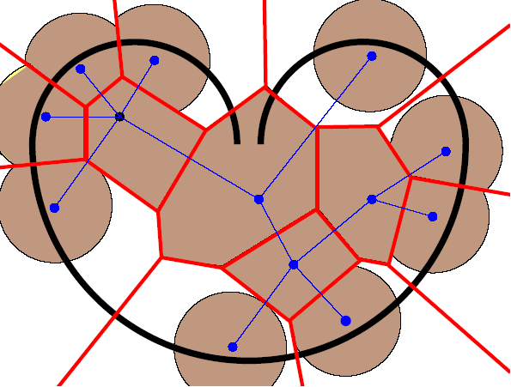
Dynamic-Domain RRT Bias

Slide 19
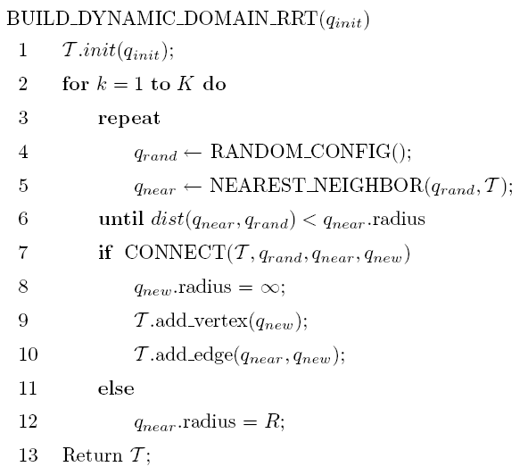
Dynamic-Domain RRT Construction

Slide 20
Dynamic-Domain RRT Bias
Tradeoff between nearest neighbor calls and collision detection calls

Slide 21
Experiments
Implementation details:
MOVE3D (LAAS/CNRS)
333 Mhz Sunblade 100 with SunOs 5.9 (not very fast)
Compiler: GCC 3.3
Fast nearest neighbor searching (Yershova [Atramentov], LaValle, 2002)
Two kinds of experiments:
Controlled experiments for toy problems
Challenging benchmarks from industry and biology

Slide 22
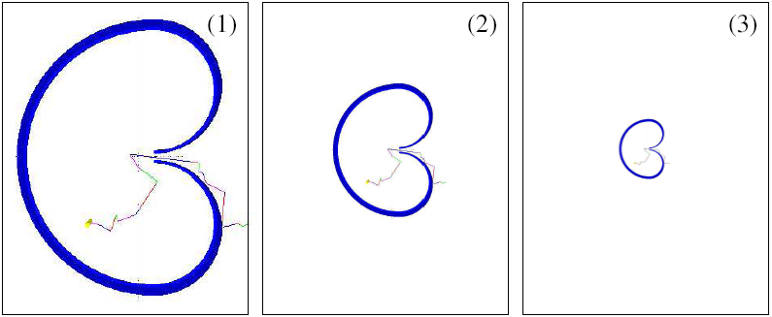
Shrinking Bug Trap
Large Medium Small

Slide 23
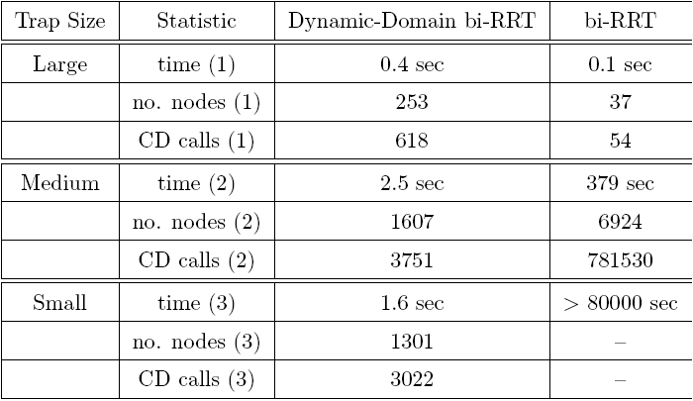
Shrinking Bug Trap
The smaller the bug trap, the better the improvement

Slide 24
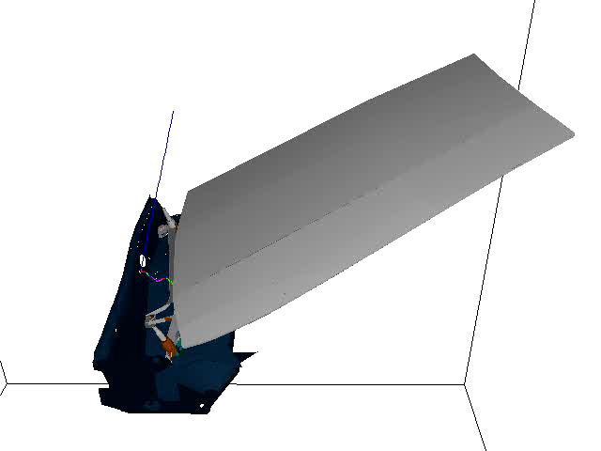
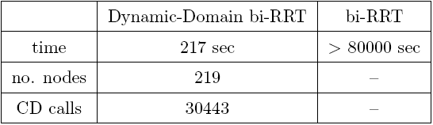
Wiper Motor (courtesy of KINEO)
6 dof problem
CD calls are expensive

Slide 25
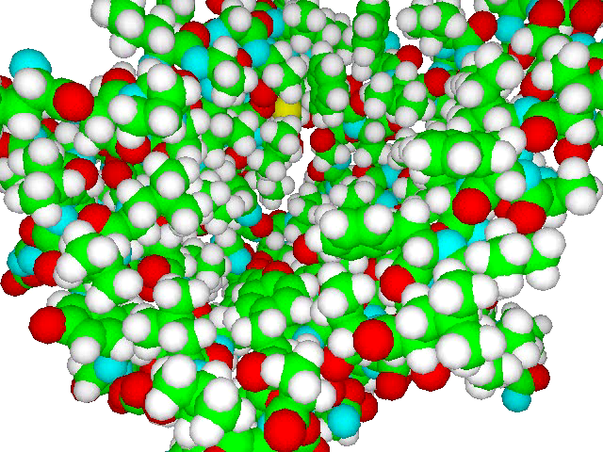
Molecule
68 dof problem was solved in 2 minutes
330 dof in 1 hour
6 dof in 1 min. 30 times improvement comparing to RRT

Slide 26
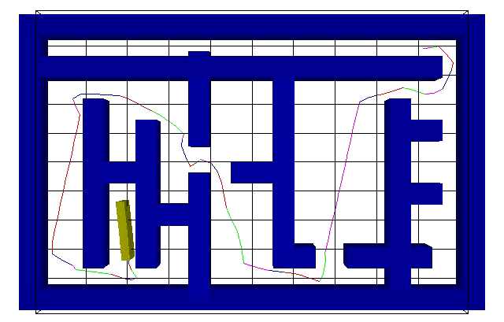
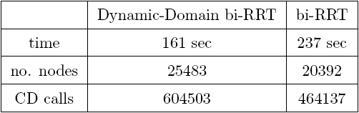
Labyrinth
3 dof problem
CD calls are not expensive

Slide 27
Conclusions
Controlling Voronoi bias is important in RRTs.
Provides dramatic performance improvements on some problems.
Does not incur much penalty for unsuitable problems.
Work in Progress:
There is a radius parameter. Adaptive tuning is possible.
(Jaillet et.al. 2005. Submitted to IROS 2005)
Application to planning under differential constraints.
Application to planning for closed chains.

